Slide 1
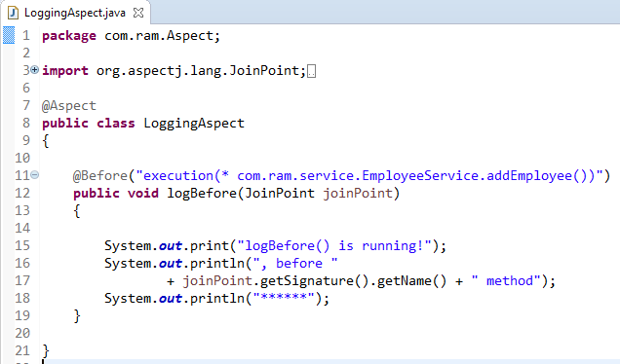
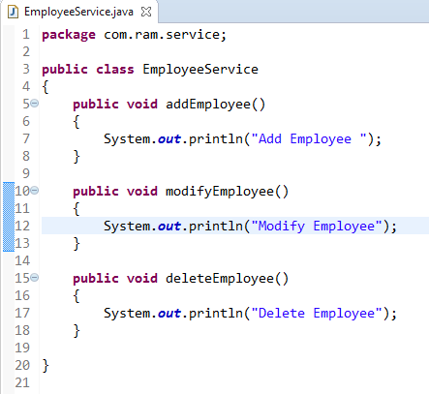
AspectJ @Before
@Before declares the before advice. it is executed before the actual method call.
@Before
AspectJ “pointcuts” is used to declare which method is going to intercept
method
1
2

Slide 2
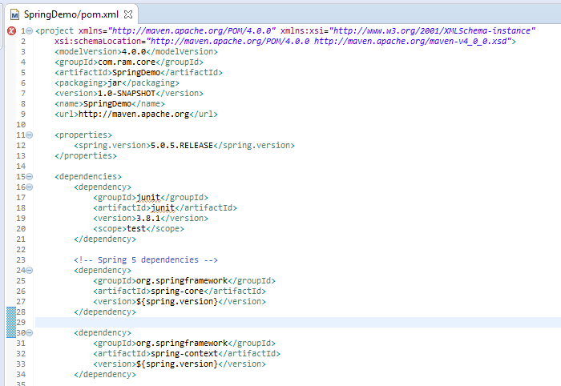
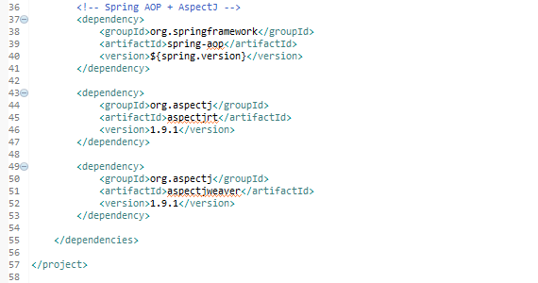
AspectJ @Before
Project Dependencies
To enable AspectJ, we need aspectjrt.jar, aspectjweaver.jar and spring-aop.jar.

Slide 3
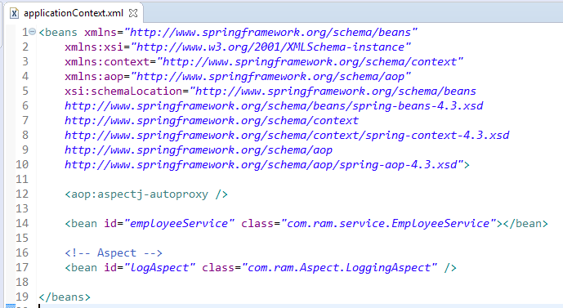
AspectJ @Before
To Enable AspectJ, In Spring configuration file, put “<aop:aspectj-autoproxy />“, and define your Aspect (interceptor) and normal bean

Slide 4
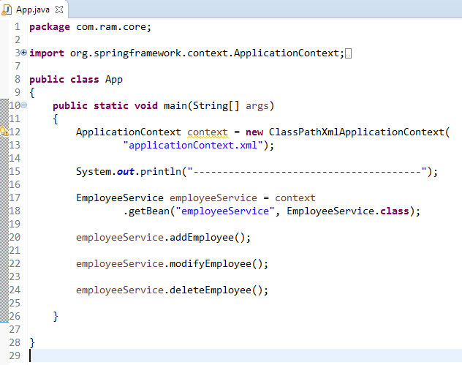
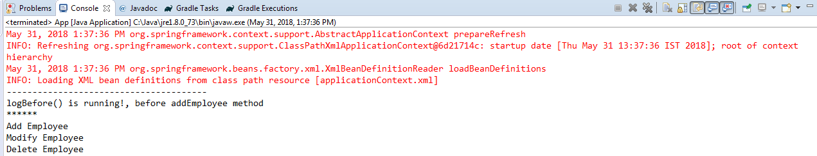
AspectJ @Before

Slide 5
AspectJ @Before
Directory Structure

